Slide 1
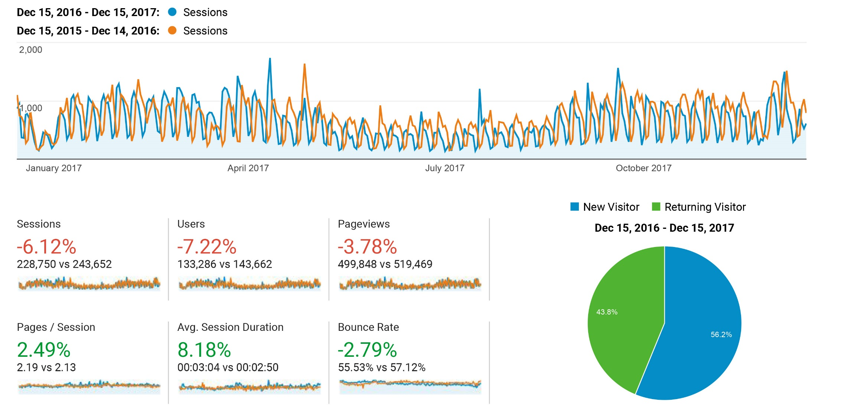
CHS Audience Overview
Note: Traffic from Majors List pages directed to department pages starting May 2015
accounts for 4.39% of lost sessions.

Slide 2
CHS Audience Drilldown
Top Countries % of traffic in 2017/2016 % Change between 2016-2017
United States 84.62% / 78.92% +0.67%
India 3.33% / 4.43% -29.41%
Philippines 1.13% / 1.47% -27.83%
Pakistan 1.06% / 1.57% -36.52%
United Kingdom 0.99% / 1.53% -39.24%
Canada 0.78% / 1.07% -31.19%
Malaysia 0.43% / 0.48% -16.01%
Bangladesh 0.43% / 0.43% -6.88%
Australia 0.41% / 0.64% -39.97%
South Korea 0.35% / 0.35% -6.50%

Slide 3
CHS Audience Drilldown
Top Cities % of traffic in 2017/2016 % Change between 2016-2017 Ames 38.55% / 34.40% +5.20%
Des Moines 3.42% / 3.43% -6.32%
Omaha 2.28% / 2.83% -24.61%
West Des Moines 1.78% / 1.17% +42.93%
Chicago 1.46% / 0.65% +111.36%
Ankeny 1.06% / 0.89% +11.19%
Madison 0.86% / 0.24% +234.92%
New York 0.68% / 0.74% -14.69%
Rounding out the top 25: Cedar Rapids (IA), Minneapolis (MN), Iowa City (IA), Urbandale (IA), Houston (TX), Washington (D.C), Bengaluru (India), Boone (IA), Davenport (IA), London (United Kingdom), Karachi (Pakistan), Los Angeles (CA), Waterloo (IA), Lahore (Pakistan), Cedar Falls (IA), Hyderabad (India)

Slide 4
CHS Audience Drilldown
Top Browsers Top Platforms Chrome 51.63% Desktop 81.90% Safari 19.93% Mobile 15.07% Firefox 12.61% Tablet 3.03% IE 7.91% Edge 3.34% (IE’s replacement) Safari (in-app) 2.61%
Note: Mobile use in 2016 was 0.97%.Tablet use went down 0.42% in 2015.

Slide 5
CHS Audience Drilldown
Top Mobile Devices – including tablets/ipads – only 4.98% of total traffic on CHS.
iPhone 47.21% ipad 13.19% Not reporting 4.05% iPhone 6s 2.97%
iPhone 7 2.57% iPhone 6 2.24% iPhone 7 Plus 1.29%
Galaxy S7 1.05%
Side note: Ruffalo Noel Levitz suggests websites need to be responsive by the time their mobile traffic reaches 11%.
However, Google Search requires it as of May 2015.

Slide 6
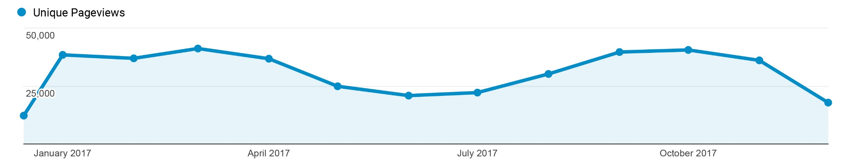
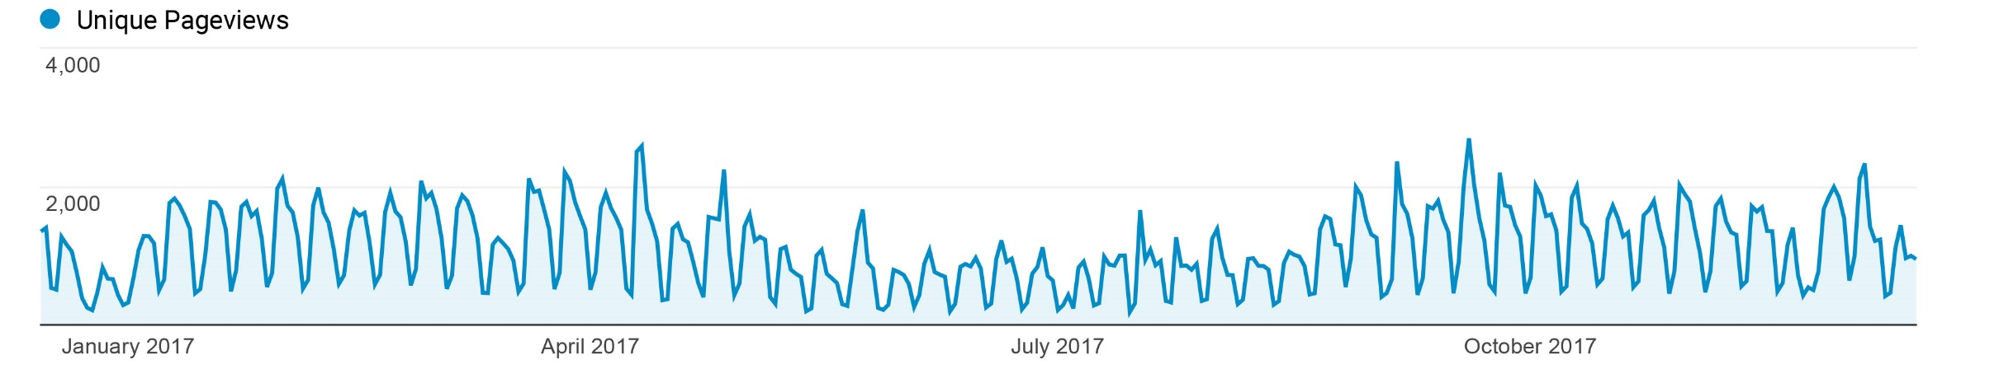
CHS Behavior Overview
Oct 2017 had the highest traffic. April, March, Feb and Jan only varied from 36,759 and 41,147 visits. May, June and July are lowest traffic months with half as many visits.
Monday’s and Tuesday’s have the highest traffic on a regular basis.
Weekends have the lowest traffic.

Slide 7
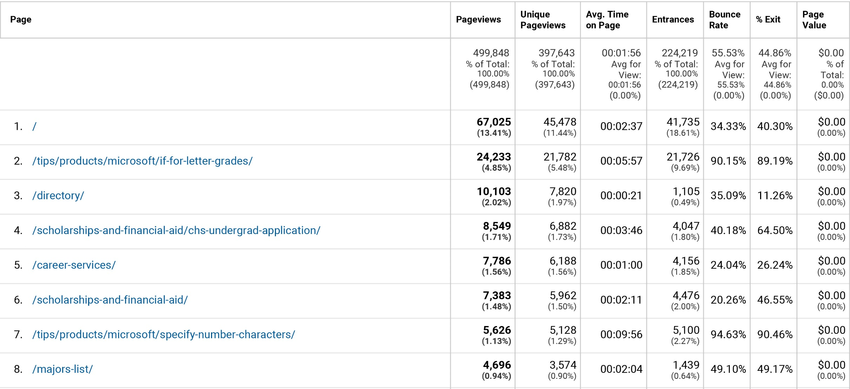
CHS Most Visited Pages

Slide 8
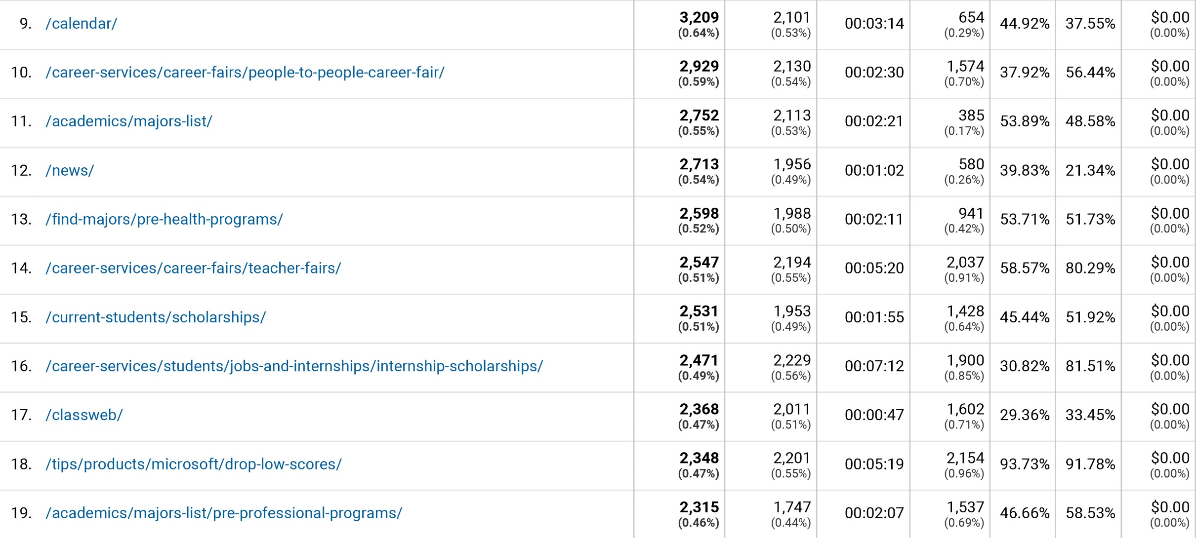
CHS Most Visited cont.

Slide 9
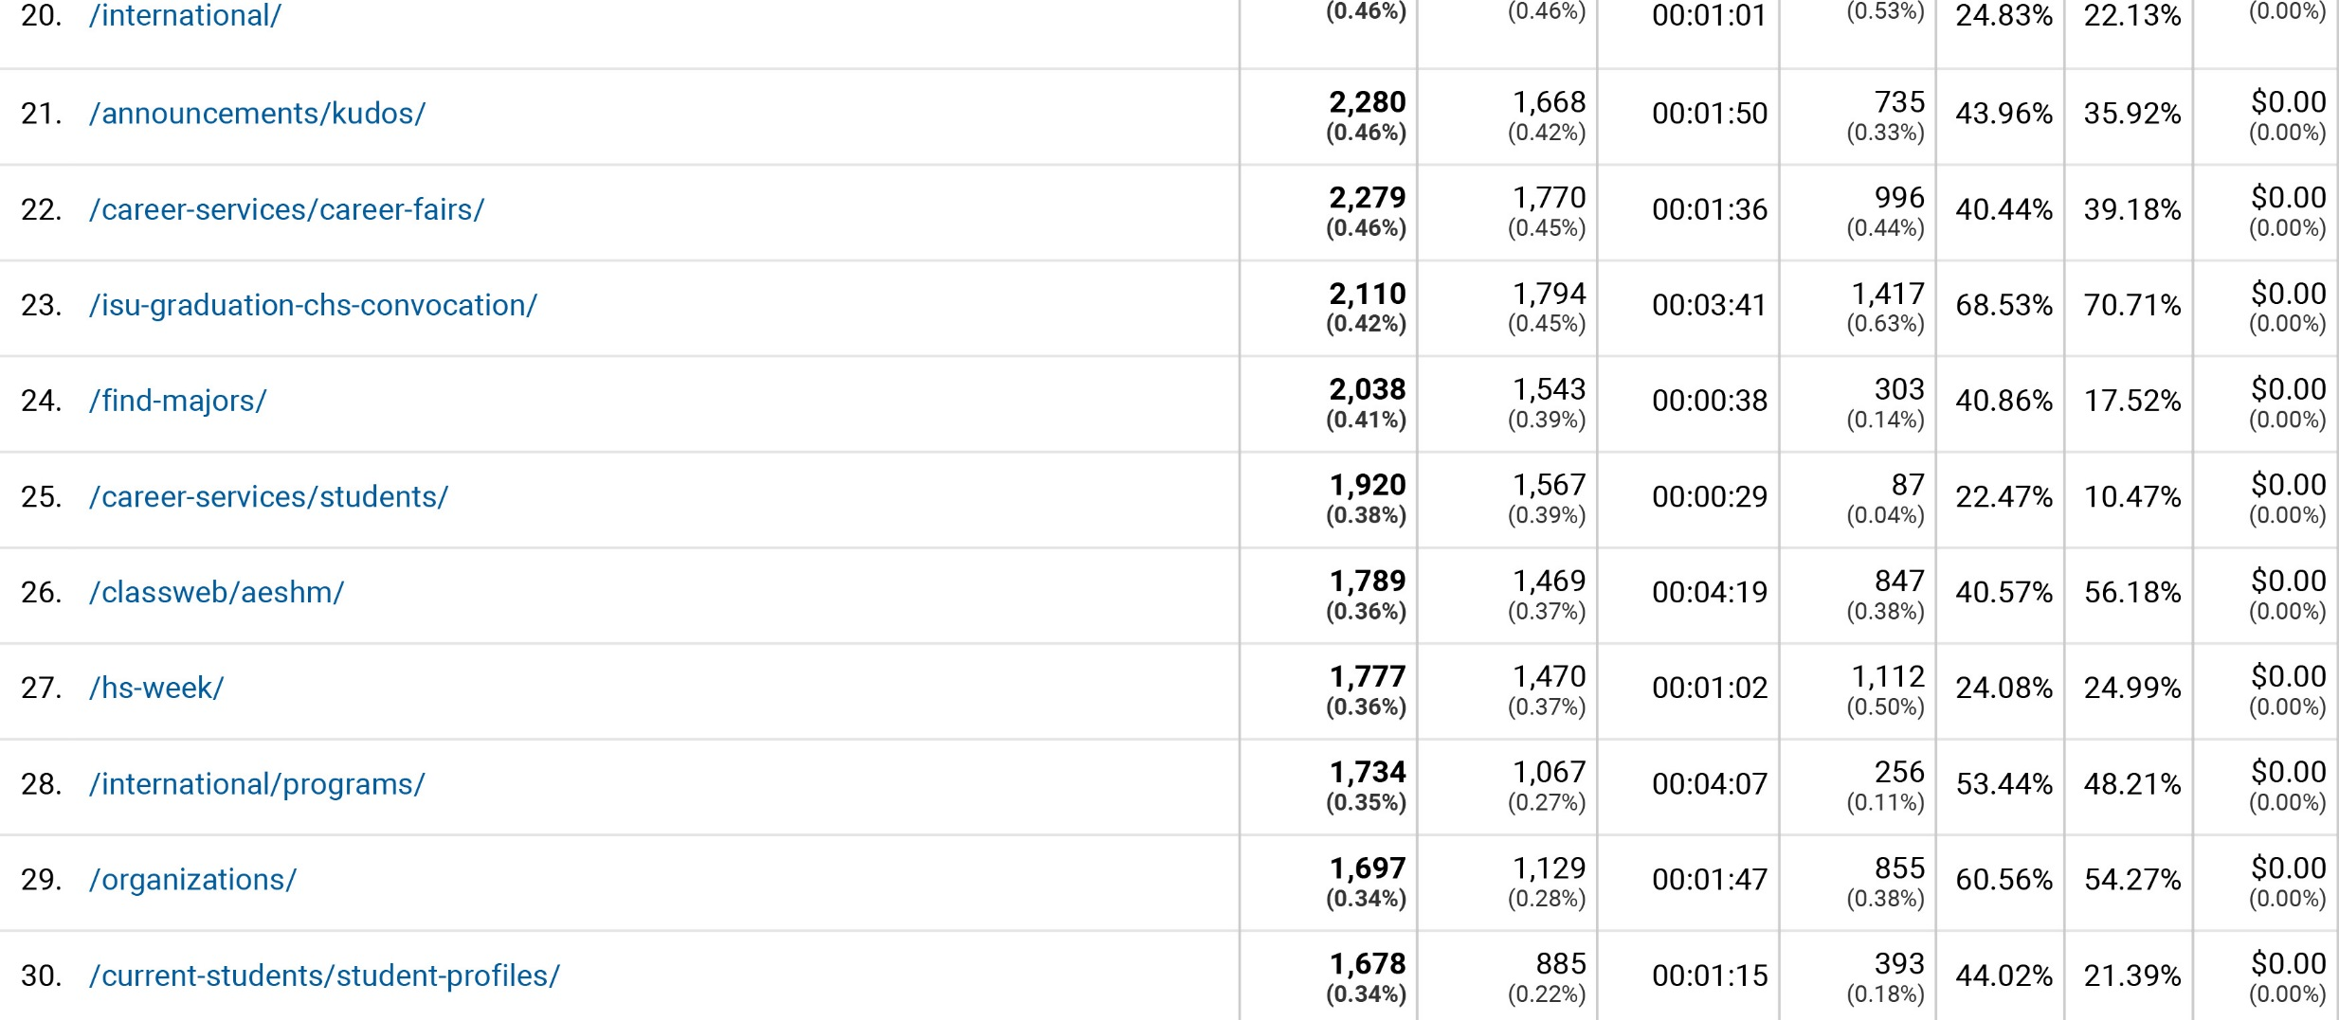
CHS Most Visited cont.

Slide 10
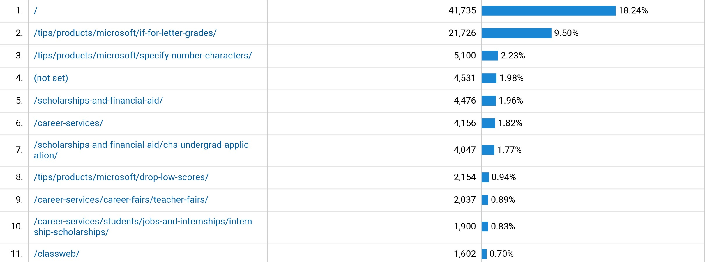
CHS Landing Pages

Slide 11
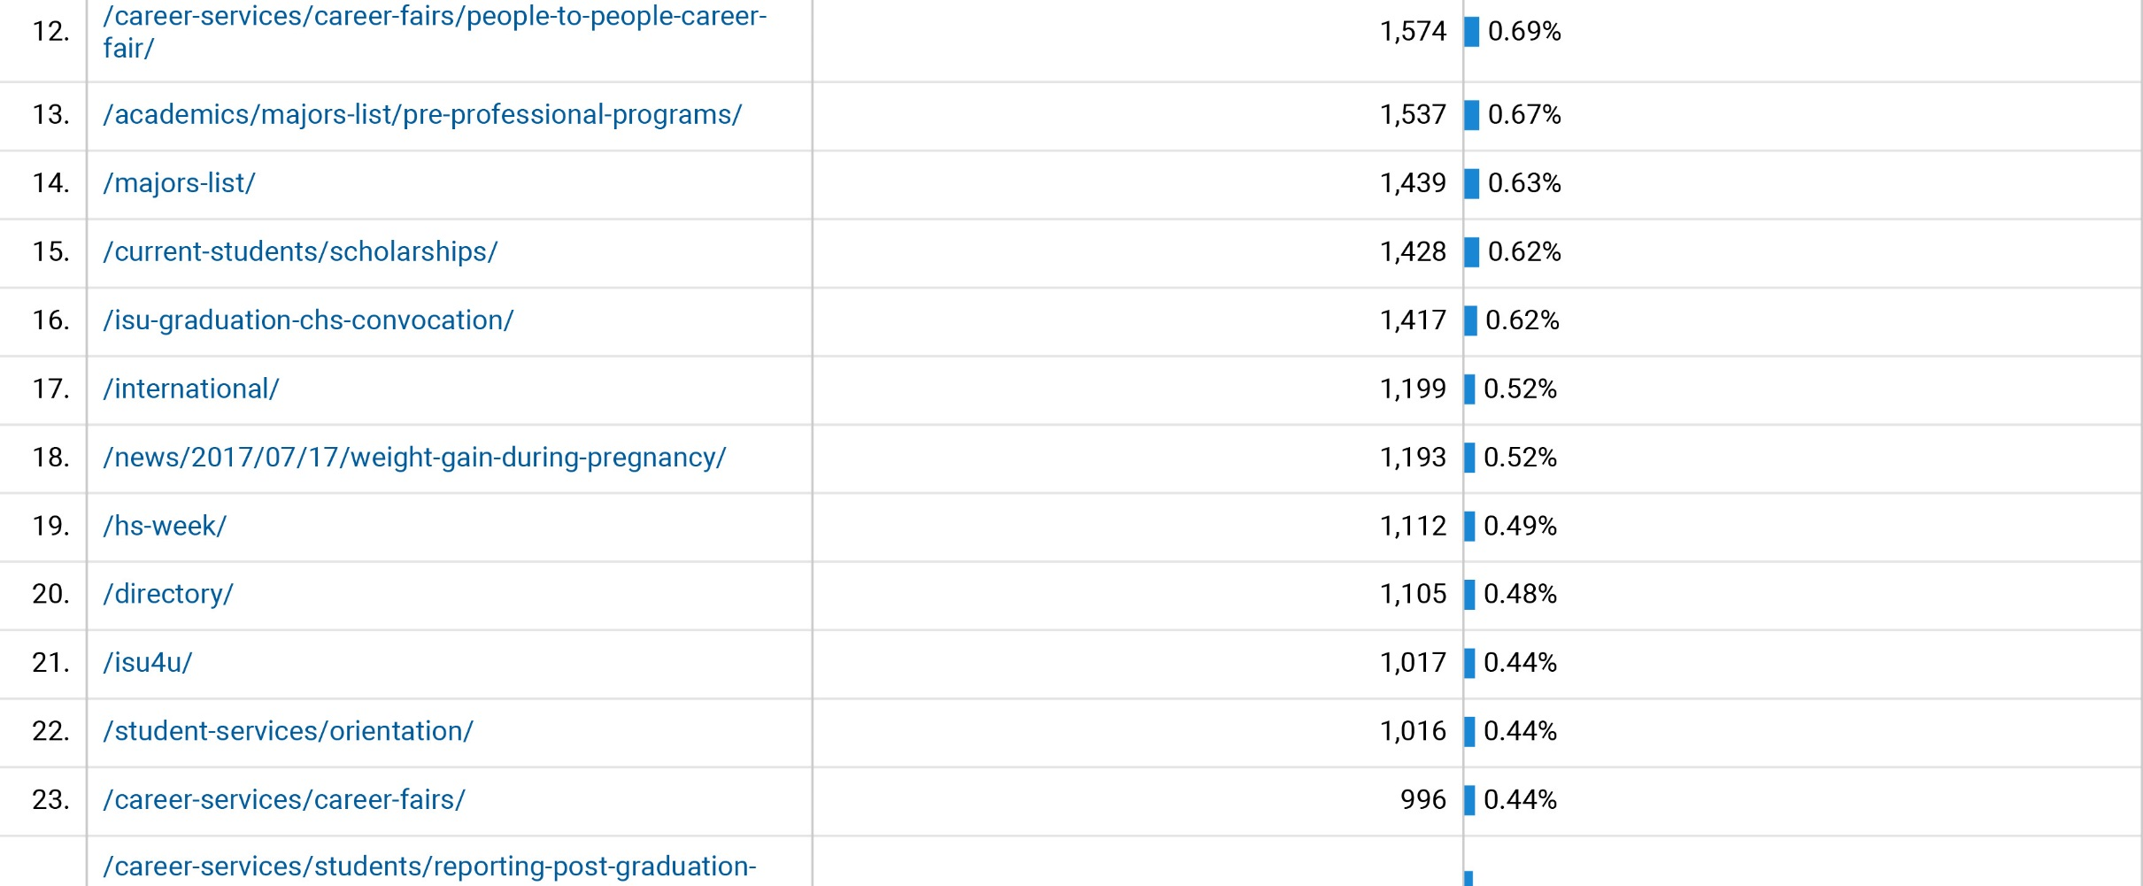
CHS Landing Pages cont.

Slide 12
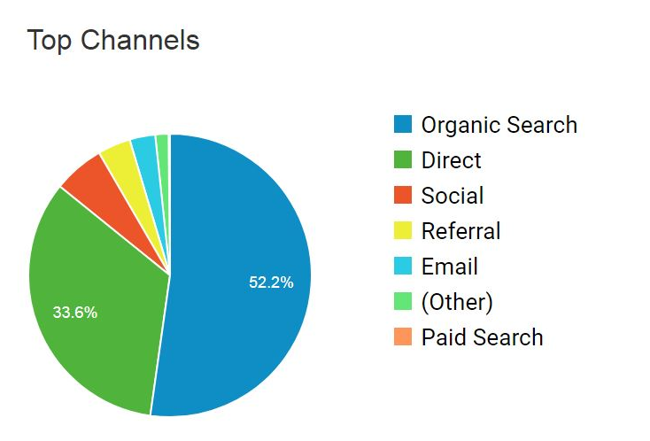
CHS Visitor Acquisition

Slide 13
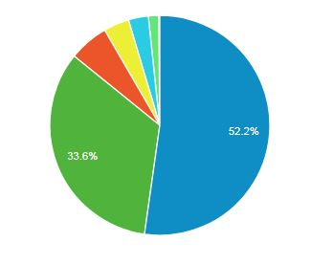
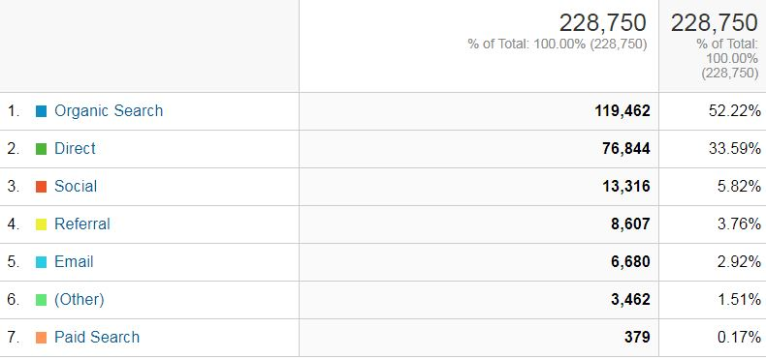
CHS Visitor Acquisition

Slide 14
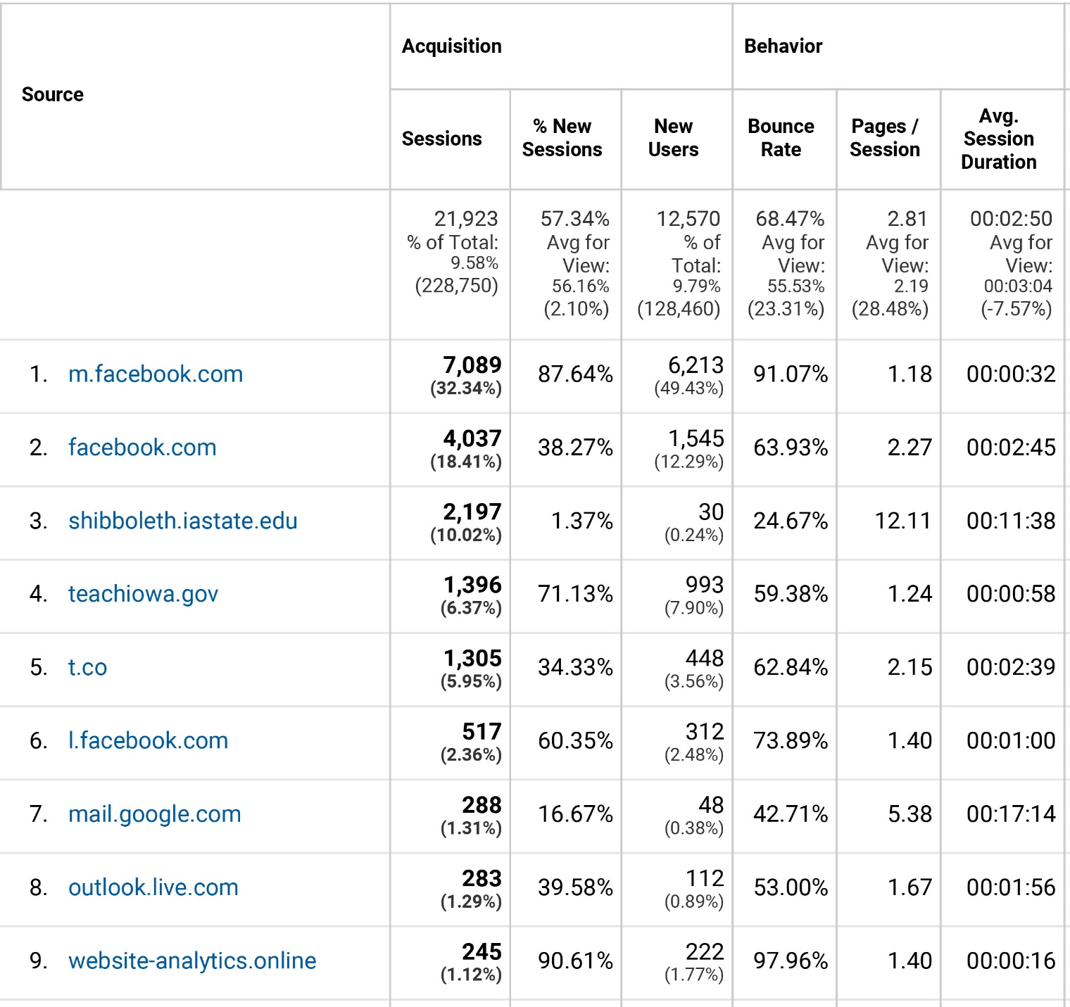
CHS Visitor
Referrals

Slide 15
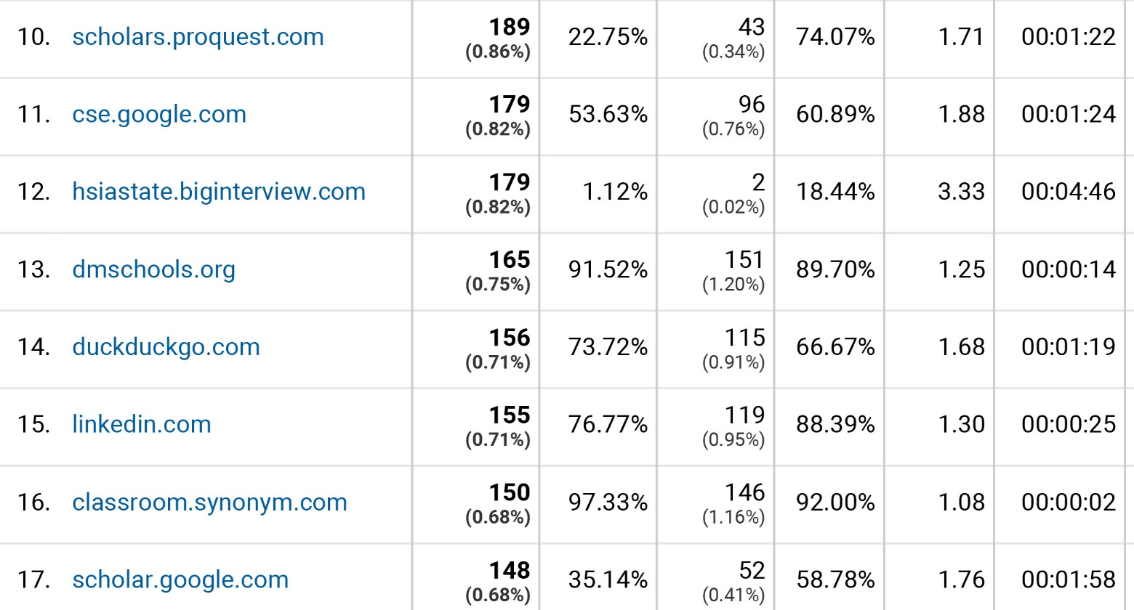
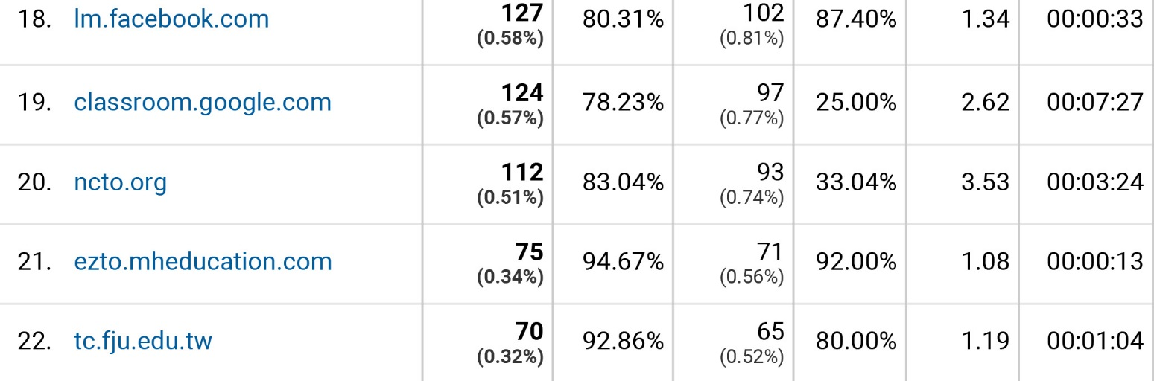
CHS Visitor
Referrals cont.

Slide 16
CHS Least Visited Pages
http://www.hs.iastate.edu/about-2/planning/strategic/vision/ 50
http://wwww.hs.iastate.edu/current-students/student-profiles/student-profiles-archive/ 50
http://www.hs.iastate.edu/isu4u/supporting-programs/urban-ecosystem-project/goal-two/ 50
http://www.hs.iastate.edu/faculty-staff/awards/factaff/faculty-award-for-diversity-enhancement 50
http://www.hs.iastate.edu /faculty-staff/awards/2017-chs-facultystaff-award-recipients/jennifer-d-smith/ 49
http://www.hs.iastate.edu/faculty-staff/awards/facstaff/career-achievement-in-teaching-award/ 49
http://www.hs.iastate.edu/faculty-staff/awards/facstaff/mid-career-achievement-in-research-award/ 49
http://www.hs.iastate.edu/prospective/find-majors/food-science-culinary-science/ 49
http://www.hs.iastate.edu/current-students/organizations/student-council/application-for-council-membership/ 48
http://www.hs.iastate.edu/academics/honors/faqs-human-sciences-honors/ 47
http://www.hs.iastate.edu/academics/honors/honors-project-proposal/ 47
http://www.hs.iastate.edu/alumni/awards/2016-chs-alumni-awards/ 47
http://www.hs.iastate.edu/current-students/international/student-resources/passport-reimbursement-program/ 47

Slide 17
CHS Least Visited Pages
http://www.hs.iastate.edu/dean-search/ 47
http://www.hs.iastate.edu/organizations/chs-student-council/application-for-council-membership/ 46
http://www.hs.iastate.edu/awards/chs-recipients/chs-2013-2/soko-starobin/ 46
http://www.hs.iastate.edu/awards/chs-recipients/chs-2010/frankie-laanan/ 45
http://www.hs.iastate.edu/awards/chs-recipients/chs-2011/dawn-filhr/ 45
http://www.hs.iastate.edu/faculty-staff/committees/diversity-equity-and-community/workshops/ 45
http://www.hs.iastate.edu/international/student-resources/start/ 45
http://www.hs.iastate.edu/student-opportunities/honors-programs/honors-project/intent-statement/ 45
http://www.hs.iastate.edu/tips/products/Microsoft/ 45
http://www.hs.iastate.edu/tips/products/Microsoft/freeze-column/ 45
http://www.hs.iastate.edu/student-opportunities/honors-program/awards-scholarships/ 44
http://www.hs.iastate.edu/alumni/awards/2008-chs-alumni-awards/stweart-l-burger/ 43
http://www.hs.iastate.edu/connect-four/ 43
http://www.hs.iastate.edu/current-students/multicultural-programs/meet-ostudents/ 43
http://www.hs.iastate.edu/prospective/find-majors/sports-athletic-training/athletic-training/ 43

Slide 18
CHS Least Visited Pages
http://www.hs.iastate.edu/tips/misc/passwords/ 43
http://www.hs.iastate.edu/awards/facstaff/career-achievement-in-teaching-award/ 42
http://www.hs.iastate.edu/faculty-staff/awards/facstaff/merit-employee-distinguished-service-award/42
http://www.hs.iastate.edu/academics/Hilton-chair/2015-2016/ 41
http://www.hs.iastate.edu/awards/chs-recipients/2013-2/ 41
http://www.hs.iastate.edu/awards/chs-recipients/2015-2/kyle-holtman/ 41
http://www.hs.iastate.edu/awards/university-awards/2015-2/carol-cordell-award-for-academic-advising-impact/ 41
http://www.hs.iastate.edu/current-students/multicultural-programs/request-funding/ 41
http://www.hs.iastate.edu/faculty-staff/awards/facstaff/career-achievement-in-research-award/ 41
http://www.hs.iastate.edu/prospective/find-majors/fitness_wellness/general_studies/ 41
http://www.hs.iastate.edu/academics/honors/program-timeline/ 40
http://www.hs.iastate.edu/awards/chs-recipients/2008-2/ana-paula-correia/ 40
http://www.hs.iastate.edu/current-students/international/getting-started/international-internships/ 40
http://www.hs.iastate.edu/hs-week/sponsors/ 40

Slide 19
CHS Least Visited Pages
http://www.hs.iastate.edu/learning-communities/minds/peer-mentors/ 40
http://www.hs.iastate.edu/student-opportunities/rosefeld-internship/history/ 40
http://www.hs.iastate.edu/faculty-staff/awards/facstaff/professional-scientific-distinguished-service-admin/ 39
http://www.hs.iastate.edu/hs-week/past-events/hs-week-2015/ 39
http://www.hs.iastate.edu/international;/getting-started/ 39
http://www.hs.iastate.edu/student-services/orientation/placement-information/ 39
http://www.hs.iastate.edu/awards/chs-recipients/2013-2/linda-serra-hagedorn/ 38
http://www.hs.iastate.edu/awards/chs-recipients/2015-2/susan-arendt/ 38
http://www.hs.iastate.edu/awards/chs-recipients/chs-2010/jean-Anderson/ 38
http://www.hs.iastate.edu/awards/chs-recipients/chs-2011/Byron-brehm-stecher/ 38
http://www.hs.iastate.edu//faculty-staff/awards/2017-chs-facultystaff-award-recipients/ronald-l eibold/ 38
http://www.hs.iastate.edu/prospective/transfer-plans-and-information/apparel-merchandising-and-design-plan/ 38

Slide 20
CHS Least Visited Pages
http://www.hs.iastate.edu/awards/chs-recipients/chs-2009/marsha-wissink/ 37
http://www.hs.iastate.edu/awards/chs-recipients/chs-2009/marsha-wissink/ 37
http://www.hs.iastate.edu/awards/chs-recipients/chs-2010/susan-arendt/ 37
http://www.hs.iastate.edu/current-students/graduation/ 37
http://www.hs.iastate.edu/current-students/international/welcome/ 37
http://www.hs.iastate.edu/explore-careers/ 37
http://www.hs.iastate.edu/prospective/parents/ 37
http://www.hs.iastate.edu/ced/admin/ 36
http://www.hs.iastate.edu/prospective/find-majors/teaching/early_childhood/ 36
http://www.hs.iastate.edu/about-2/visitors/ 35
http://www.hs.iastate.edu/faces-iowa-state/ 35
http://www.hs.iastate.edu/student-opportunities/honors-program/faculty-roles/become-a-project-advisor/ 35
http://www.hs.iastate.edu/about-2/key-initiatives/diversity-and-social-justice/ 34
http://www.hs.iastate.edu/about-2/points-of-pride/life-and-lore-of -mackey-hall/the-ring-of-life/ 34

Slide 21
CHS Least Visited Pages
http://www.hs.iastate.edu/awards/chs-recipients/chs-2011/lakshman-rajagopal/ 34
http://www.hs.iastate.edu/faculty-staff/awards/deans-faculty-fellows-award/2015-Byron-brehm-stecher/ 34
http://www.hs.iastate.edu/international/faculty-staff-resources/international-programs-committee/ 34
http://www.hs.iastate.edu/internation/program-development-grants/louise-m-rosenfeld-fund/ 34
http://www.hs.iastate.edu/tips/ 34
http://www.hs.iastate.edu/awards/chs-recipients/2012-2/ 33
http://www.hs.iastate.edu/awards/chs-recipients/2012-2/Thomas-schrier/ 33
http://www.hs.iastate.edu/awards/chs-recipients/chs-2011/ 33
http://www.hs.iastate.edu/awards/rossmann-manatt/2014-sara-marcketti/ 33
http://www.hs.iastate.edu/tips/products/ 33
http://www.hs.iastate.edu/awards/chs-recipients/2016/laura-ellingson/ 32
http://www.hs.iastate.edu/awards/chs-recipients/2016-2/victor-miller/ 32
http://www.hs.iastate.edu/awards/facstaff/professional-scientific-distinguished -service/ 32
http://www.hs.iastate.edu/councils-committees/deans-advisory-council/2017-2018-deans-advisory-council/ 32

Slide 22
CHS Least Visited Pages
http://www.hs.iastate.edu/dean-pamela-white/ 32
http://www.hs.iastate.edu/faculty-staff/awards/2017-chs-facultystaff-award-recipients/Christine-fedler/ 32
http://www.hs.iastate.edu/faculty-staff/awards/facstaff/faculty-award-for-international-achievement/ 32
http://www.hs.iastate.edu/prospective/apply/ 32
http://www.hs.iastate.edu/academics/honors/awards/-scholarships/ 31
http://www.hs.iastate.edu/alumni/alumni-awards/2017-chs-alumni-awards/jerlando-jackson/ 31
http://www.hs.iastate.edu/faculty-staff/safety/ 31
http://www.hs.iastate.edu/prospective/find-majors/children-youth-family/youth/ 31
http://www.hs.iastate.edu/student-opportunities/honor-program/peer-mentors/ 31
http://www.hs.iastate.edu/student-services/academic-advising/chs-academic-committee/ 31
http://www.hs.iastate.edu/awards/chs-recipients/2014-2/amy-hutchinson/ 30
http://www.hs.iastate.edu/awards/chs-recipients/chs-2009/denise-denton/ 30
http://www.hs.iastate.edu/awards/university-awards/2016-2/peter-martin/ 30
http://www.hs.iastate.edu/awards/university-awards/university-2009/nancy-evans/ 30

Slide 23
CHS Least Visited Pages
http://www.hs.iastate.edu/current-students/international/getting-started/why-study-abroad/ 30
http://www.hs.iastate.edu/current-students/isu-graduation-chs-convocation/graduates/ 30
http://www.hs.iastate.edu/faculty-staff/awards/facstaff/career-achievement-in-outreach-awar d/ 30
http://www.hs.iastate.edu/tips/email/email-list/ 30
http://www.hs.iastate.edu/about-2/points-of-pride/life-and-lore-of-mackay-hall/the-batchelder-fountains/ 29
http://www.hs.iastate.edu/announcements/search/ 29
http://www.hs.iastate.edu/awards/chs-recipients/2008-2/corey-drake/ 29
http://www.hs.iastate.edu/awards/chs-recipients/2012-2/erica-beirman/ 29
http://www.hs.iastate.edu/awards/deans-faculty-fellows-award/ 29
http://www.hs.iastate.edu/content/exhibits/admin/?x=add_equipment 29
http://www.hs.iastate.edu/current-students/international/getting-started/application-process/ 29
http://www.hs.iastate.edu/faculty-staff/awards/2017-university-award-recipients/tera-lawson/ 29
http://www.hs.iastate.edu/international/services-and-support/ 29
http://www.hs.iastate.edu/multicultural-programs-office/professional-development-funding/ 29
http://www.hs.iastate.edu/academics/honors/peer-mentors/ 28

Slide 24
CHS Least Visited Pages
http://www.hs.iastate.edu/awards/chs-recipients/2012-2/kim-greder/ 28
http://www.hs.iastate.edu/awards/chs-recipients/2014-2/karen-colbert/ 28
http://www.hs.iastate.edu/awards/chs-recipients/2016-2/ann-smiley-oyen/ 28
http://www.hs.iastate.edu/awards/chs-recipients/chs-2010/laura-rendon/ 28
http://www.hs.iastate.edu/faculty-staff/awards/2016-university-awards/jeanne-stewart/ 28
http://www.hs.iastate.edu/faculty-staff/building/building-supervisors/ 28
http://www.hs.iastate.edu/about-2/people/deans-advisory-council/2015-16-deans-advisory-cou ncil/ 27
http://www.hs.iastate.edu/awards/chs-recipients/2008-2/cathy-hockaday/ 27
http://www.hs.iastate.edu/awards/chs-recipients/2016-2/larry-ebbers/ 27
http://www.hs.iastate.edu/awards/chs-recipients/2016-2/leah-kinnaird/ 27
http://www.hs.iastate.edu/awards/facstaff/mid-career-achievement-in-research-award/ 27
http://www.hs.iastate.edu/awards/facstaff/outstanding-advisor-award/ 27
http://www.hs.iastate.edu/faculty-staff/safety/fire-prevention/ 27
http://www.hs.iastate.edu/hs-week/past-events/hs-week-2017/ 27
http://www.hs.iastate.edu/it/labs/ 27

Slide 25
CHS Least Visited Pages
http://www.hs.iastate.edu//current-students/international/program-development-grants/louisem-rosenfeld-fund/ 26
http://www.hs.iastate.edu/current-students/international/programs/global-partnerships/ 26
http://www.hs.iastate.edu/prospective/find-majors/children-youth-family/families-adults/ 26
http://www.hs.iastate.edu/prospective/transfer-plans-and-information/community-college-equiv alency-guides-for-child-adult-family-services/ 26
http://www.hs.iastate.edu/prospective/transfer-students/ 26
http://www.hs.iastate.edu/surveys/consent/ 26
http://www.hs.iastate.edu/alumni/alumni-awards/2016-chs-alumni-awards/ 25
http://www.hs.iastate.edu/alumni/awards/2002-chs-alumni-awards/don-and-ardyce-roehr/ 25
http://www.hs.iastate.edu/alumni/awards/2007-chs-alumni-awards/kent-koppelman/ 25
http://www.hs.iastate.edu/alumni/awards/2013-chs-alumni-awards/ann-thompso/ 25
http://www.hs.iastate.edu/awards/chs-recipients/2013-2/ann-pierce/ 25
http://www.hs.iastate.edu/awards/chs-recipients/2015-2/natasha-croom/ 25
http://www.hs.iastate.edu/awards/facstaff/lecturerclinicianadjunct-faculty-distinguished-servic e-award/25

Slide 26
CHS Least Visited Pages
http://www.hs.iastate.edu/current-students/graduate-students/department-information/ 25
http://www.hs.iastate.edu/current-students/international/information__trashed/passports/ 25
http://www.hs.iastate.edu/current-students/scholarships/middle-school-science-and-technolog y-scholarship/ 25
http://www.hs.iastate.edu/current-students/student-sensations-award/ 25
http://www.hs.iastate.edu/international/faculty-staff-resources/rome-initiatve/ 25
http://www.hs.iastate.edu/international/student-resources/hs-global-citizens-club/ 25
http://www.hs.iastate.edu/student-opportunities/honors-program/honors-project/project-presen tation/ 25
http://www.hs.iastate.edu/tips/products/microsoft/compress-images/ 25
http://www.hs.iastate.edu/tips/products/skype/ 24
http://www.hs.iastate.edu/academics/honors/program-overview/benefits/ 24
http://www.hs.iastate.edu/alumni/awards/2015-chs-alumni-awards/richard-l-mahoney/ 24
http://www.hs.iastate.edu/awards/chs-recipients/2015-2/wendy-white/ 24
http://www.hs.iastate.edu/awards/chs-recipients/2016-2/byron-brehm-stecher/ 24
http://www.hs.iastate.edu/awards/facstaff/early-achievement-in-teaching-award/ 24

Slide 27
CHS Least Visited Pages
http://www.hs.iastate.edu/awards/rossmann-manatt/2012-2/ 24
http://www.hs.iastate.edu/tips/products/respondus/ 24
http://www.hs.iastate.edu/alumni/newsletter/online-archive/ 23
http://www.hs.iastate.edu/announcements/subscribe/friend-unsubscribe 23
http://www.hs.iastate.edu/awards/chs-recipients/2012-2/catherine-strohbehn/ 23
http://www.hs.iastate.edu/awards/chs-recipients/2016-2/suzanne-bartholomae/ 23
http://www.hs.iastate.edu/awards/facstaff/early-achievement-in-outreach-award/ 23
http://www.hs.iastate.edu/awards/facstaff/professional-scientific-distinguished-service-admin/ 23
http://www.hs.iastate.edu/current-students/student-services/resources/transcripts/ 23
http://www.hs.iastate.edu/faculty-staff/awards/2017-university-award-recipients/tera-r-jordan/ 23
http://www.hs.iastate.edu/prospective/find-majors/fitness_wellness/exercise_science/ 23
http://www.hs.iastate.edu/prospective/transfer-plans-and-information/event-management-trans fer-plans/ 23
http://www.hs.iastate.edu/alumni/alumni-awards/2017-chs-alumni-awards/david-walker/ 22
http://www.hs.iastate.edu/announcements/subscribe/alum-unsubscribe/ 22

Slide 28
CHS Least Visited Pages
http://www.hs.iastate.edu/awards/chs-recipients/2016-2/hector-angus/ 22
http://www.hs.iastate.edu/awards/facstaff/professional-scientific-early-achievement-admin/ 22
http://www.hs.iastate.edu/awards/university-awards/2011-2/sara-marcketti/ 22
http://www.hs.iastate.edu/career-services/employers/recruiting-visits/ 22
http://www.hs.iastate.edu/international-writing-assistance/ 22
http://www.hs.iastate.edu/international/student-resources/health-and-safety-abroad/ 22
http://www.hs.iastate.edu/it/labs/reservations.htm 22
http://www.hs.iastate.edu/tips/products/microsoft/files-too-large/ 22
http://www.hs.iastate.edu/accreditation-2012/mission/ 21
http://www.hs.iastate.edu/exhibits/admin/?p=view_archived_reservations 21
http://www.hs.iastate.edu/faculty-staff/classroom-resources/ 21
http://www.hs.iastate.edu/hsweek/thank-2017-sponsors/ 21
http://www.hs.iastate.edu/isu4u/scholarly-efforts/ 21
http://www.hs.iastate.edu/prospective/learning-communities/minds/ 21
http://www.hs.iastate.edu/research/timeline/ 21
http://www.hs.iastate.edu/alumni/alumni-awards/2017-chs-alumni-awards/herma-barclay-willia ms/ 20

Slide 29
CHS Least Visited Pages
http://www.hs.iastate.edu/alumni/alumni-awards/2017-chs-alumni-awards/martha-l-gleason/ 20
http://www.hs.iastate.edu/awards/chs-recipients/2014-2/daniel-robinson/ 20
http://www.hs.iastate.edu/awards/university-awards/2011-2/barbara-woods/ 20
http://www.hs.iastate.edu/awards/university-awards/2016-2/ann-marie-fiore/ 20
http://www.hs.iastate.edu/current-students/student-profiles/student-profiles-archive/kin/ 20
http://www.hs.iastate.edu/evan-fritz/ 20
http://www.hs.iastate.edu/prospective/transfer-plans-and-information/financial-counseling-andplanning-transfer-plans/ 20
http://www.hs.iastate.edu/tips/web-html/ 20
http://www.hs.iastate.edu/academics/honors/honors-project/intent-statement/ 19
http://www.hs.iastate.edu/accrediting-bodies 19
http://www.hs.iastate.edu/alumni/awards/2007-chs-alumni-awards/nawal-el-moutawakel/ 19
http://www.hs.iastate.edu/alumni/awards/2010-alumni-awards/virginia-k-olsen-molgaard/ 19
http://www.hs.iastate.edu/alumni/awards/2015-chs-alumni-awards/ 19
http://www.hs.iastate.edu/awards/chs-recipients/2008-2/ann-guddall/ 19

Slide 30
CHS Least Visited Pages
http://www.hs.iastate.edu/awards/chs-recipients/2012-2/nana-osei-kofi/ 19
http://www.hs.iastate.edu/awards/chs-recipients/2013-2/tera-lawson/ 19
http://www.hs.iastate.edu/dynette-mosher/ 19
http://www.hs.iastate.edu/faculty-staff/sustainability/sustainability-resources/ 19
http://www.hs.iastate.edu/international/program-development-grants/ 19
http://www.hs.iastate.edu/multicultural-programs-office/get-connected/ 19
http://www.hs.iastate.edu/prospective/visit/group_visits/ 19
http://www.hs.iastate.edu/tips/products/microsoft/auto-list-formation/ 19
http://www.hs.iastate.edu/awards/chs-recipients/2013-2/gayle-luze/ 18
http://www.hs.iastate.edu/awards/chs-recipients/2014-2/jaqueline-krogh/ 18
http://www.hs.iastate.edu/awards/chs-recipients/chs-2009/lori-d-patton/ 18
http://www.hs.iastate.edu/current-students/multicultural-programs/request-a-tutor/ 18
http://www.hs.iastate.edu/current-students/multicultural-programs/scholarships/ 18
http://www.hs.iastate.edu/faculty-staff/committees/diversity-equity-and-community/articles/ 18
http://www.hs.iastate.edu/it/labs/facilities.htm 18

Slide 31
CHS Least Visited Pages
http://www.hs.iastate.edu/it/requestforms/homepage.php 18
http://www.hs.iastate.edu/prospective/transfer-plans-and-information/early-childhood-educatio n-transfer-plans/ 18
http://www.hs.iastate.edu/safety/ 18
http://www.hs.iastate.edu/student-services/adviser-resources/academic-advising/ 18
http://www.hs.iastate.edu/alumni/awards/2012-chs-alumni-awards/ 17
http://www.hs.iastate.edu/awards/chs-recipients/2015-2/denise-nichols/ 17
http://www.hs.iastate.edu/awards/chs-recipients/chs-2009/ 17
http://www.hs.iastate.edu/awards/facstaff/career-achievement-in-research-award/ 17
http://www.hs.iastate.edu/awards/university-awards/2015-2/ 17
http://www.hs.iastate.edu/current-students/student-profiles/student-profiles-archive/fshn/ 17
http://www.hs.iastate.edu/about-2/people/deans-advisory-council/2013-14-deans-advisory-cou ncil/ 16
http://www.hs.iastate.edu/alumni/awards/201-alumni/ 16
http://www.hs.iastate.edu/alumni/awards/2013-chs-alumni-awards/ 16
http://www.hs.iastate.edu/alumni/newsletter/dean-whites-retirement-announcement/ 16

Slide 32
CHS Least Visited Pages
http://www.hs.iastate.edu/awards/chs-recipients/2014-2/carl-smith/ 16
http://www.hs.iastate.edu/awards/chs-recipients/2014-2/theresa-boettcher/ 16
http://www.hs.iastate.edu/awards/deans-faculty-fellows-award/2016-2018-linda-niehm/ 16
http://www.hs.iastate.edu/awards/university-awards/2010-university/mary-meier/ 16
http://www.hs.iastate.edu/awards/university-awards/2014-university-awards/ 16
http://www.hs.iastate.edu/awards/university-awards/2014-university-awards/linda-niehm/ 16
http://www.hs.iastate.edu/exhibits/admin/ 16
http://www.hs.iastate.edu/faculty-staff/awards/chs-recipients/byron-brehm-stecher/ 16
http://www.hs.iastate.edu/larry-ebbers/ 16
http://www.hs.iastate.edu/multicultural-programs-office/get-connected/events/ 16
http://www.hs.iastate.edu/academics/honors/program-overview/admission/ 15
http://www.hs.iastate.edu/alumni/awards/1997-chs-alumni-awards/willie-lee-campbell-glass/ 15
http://www.hs.iastate.edu/alumni/awards/2011-chs-alumni-awards/ 15
http://www.hs.iastate.edu/alumni/awards/2011-chs-alumni-awards/larry-h-ebbers/ 15
http://www.hs.iastate.edu/awards/chs-recipients/2012-2/linda-svendsen/ 15
http://www.hs.iastate.edu/awards/chs-recipients/2015-2/dennelle-hogan/ 15
http://www.hs.iastate.edu/awards/chs-recipients/2016-2/jean-anderson/ 15
http://www.hs.iastate.edu/faculty-staff/awards/2016-university-awards/nicci-port/ 15

Slide 33
CHS Least Visited Pages
http://www.hs.iastate.edu/international/family-resources/ 15
http://www.hs.iastate.edu/prospective/find-majors/children-youth-family/pre-professional/ 15
http://www.hs.iastate.edu/academics/honors/faculty-roles/ 15
http://www.hs.iastate.edu/alumni/alumni-awards/2017-chs-alumni-awards/constance-p-hargra ve/ 14
http://www.hs.iastate.edu/alumni/alumni-awards/2017-chs-alumni-awards/cristobal_salinas/ 14
http://www.hs.iastate.edu/alumni/alumni-awards/2017-chs-alumni-awards/tinika-y-roland/ 14
http://www.hs.iastate.edu/alumni/awards/2006-chs-alumni-awards/robert-reason/ 14
http://www.hs.iastate.edu/alumni/awards/2009-chs-alumni-awards/corly-brooke/ 14
http://www.hs.iastate.edu/alumni/awards/2009-chs-alumni-awards/phil-caffrey/ 14
http://www.hs.iastate.edu/alumni/awards/2010-alumni-awards/alumni-achievement-award-2/ 14
http://www.hs.iastate.edu/alumni/awards/2010-alumni-awards/nancy-evans/ 14
http://www.hs.iastate.edu/awards/chs-recipients/2013-2/eunice-bassler/ 14
http://www.hs.iastate.edu/awards/chs-recipients/2015-2/katherine-rb/ 14
http://www.hs.iastate.edu/awards/chs-recipients/2015-2/mary-jo-beckman/ 14
http://www.hs.iastate.edu/awards/chs-recipients/chs-2009/manju-reddy/ 14
http://www.hs.iastate.edu/awards/university-awards/2011-2/ 14
http://www.hs.iastate.edu/awards/university-awards/2013-2/ 14
http://www.hs.iastate.edu/content/multimedia/ 14

Slide 34
CHS Least Visited Pages
http://www.hs.iastate.edu/current-students/international/program-development-grants/m-cathe rine-welsh-fund/ 14
http://www.hs.iastate.edu/current-students/student-profiles/student-profiles-archive/hdfs/ 14
http://www.hs.iastate.edu/faculty-staff/awards/chs-recipients/laura-ellingson/ 14
http://www.hs.iastate.edu/hs-week/call-for-research/ 14
http://www.hs.iastate.edu/international-activities-grants/ 14
http://www.hs.iastate.edu/prospective/find-majors/financial-literacy/family-finance/ 14
http://www.hs.iastate.edu/research/research-archive/ 14
http://www.hs.iastate.edu/safety/individual-responsibility/ 14
http://www.hs.iastate.edu/alumni/alumni-awards/2016-chs-alumni-awards/tyler-weig/ 13
http://www.hs.iastate.edu/alumni/awards/1998-chs-alumni-awards/margaret-arcus/ 13
http://www.hs.iastate.edu/alumni/awards/201-alumni/christopher-duree/ 13
http://www.hs.iastate.edu/alumni/awards/2010-alumni-awards/ 13
http://www.hs.iastate.edu/awards/chs-recipients/2008-2/ 13
http://www.hs.iastate.edu/awards/chs-recipients/2012-2/janell-meyer/ 13
http://www.hs.iastate.edu/awards/chs-recipients/chs-2010/sara-marcketti/ 13
http://www.hs.iastate.edu/awards/facstaff/early-achievement-in-research-award/ 13
http://www.hs.iastate.edu/awards/university-awards/2013-2/ann-marie-fiore/ 13

Slide 35
CHS Least Visited Pages
http://www.hs.iastate.edu/faculty-staff/awards/chs-recipients/jean-anderson-2/ 13
http://www.hs.iastate.edu/faculty-staff/awards/facstaff/professional-scientific-distinguished-se rvice/ 13
http://www.hs.iastate.edu/faculty-staff/committees/diversity-equity-and-community/articles-an d-notes/a-plea-for-civility/ 13
http://www.hs.iastate.edu/faculty-staff/safety/safety-committee/ 13
http://www.hs.iastate.edu/international/international-programs-committee/ 13
http://www.hs.iastate.edu/prospective/find-majors/financial-literacy/housing-or-family-policy/ 13
http://www.hs.iastate.edu/alumni/alumni-awards/2016-chs-alumni-awards/joyce-hoppes/ 12
http://www.hs.iastate.edu/alumni/awards/1966-1995-chs-alumni-awards/ 12
http://www.hs.iastate.edu/alumni/awards/2006-chs-alumni-awards/bernhard-hennig/ 12
http://www.hs.iastate.edu/alumni/awards/2008-chs-alumni-awards/ 12
http://www.hs.iastate.edu/alumni/awards/201-alumni/carol-l-anderson/ 12
http://www.hs.iastate.edu/alumni/awards/2011-chs-alumni-awards/myrna-and-alan-tubbs/ 12
http://www.hs.iastate.edu/awards/chs-recipients/2008-2/janeann-stout/ 12
http://www.hs.iastate.edu/awards/chs-recipients/2012-2/mary-jane-brotherson/ 12
http://www.hs.iastate.edu/awards/chs-recipients/2015-2/annette-jaehrling/ 12
http://www.hs.iastate.edu/awards/chs-recipients/2015-2/arlene-de-la-mora/ 12
http://www.hs.iastate.edu/current-students/international/student-resources/global-citizens-pro gram/ 12

Slide 36
CHS Least Visited Pages
http://www.hs.iastate.edu/diversity-and-inclusion/articles/a-plea-for-civility/ 12
http://www.hs.iastate.edu/faculty-staff/awards/chs-recipients/lisa-enloe/ 12
http://www.hs.iastate.edu/faculty-staff/committees/diversity-equity-and-community/workshop s/spring-2017/ 12
http://www.hs.iastate.edu/prospective/transfer-plans-and-information/elementary-education-tra nsfer-plans/ 12
http://www.hs.iastate.edu/tips/misc/performance/ 12
http://www.hs.iastate.edu/tips/products/audacity/ 12
http://www.hs.iastate.edu/webhelp/ 12
http://www.hs.iastate.edu/about-2/planning/strategic/about-the-process/ 11
http://www.hs.iastate.edu/alumni-and-visitors/alumni/online-archive/ 11
http://www.hs.iastate.edu/alumni/alumni-awards/2016-chs-alumni-awards/david-walker/ 11
http://www.hs.iastate.edu/alumni/awards/1996-chs-alumni-awards/ 11
http://www.hs.iastate.edu/alumni/awards/2001-chs-alumni-awards/roger-a-smith/ 11
http://www.hs.iastate.edu/alumni/awards/2002-chs-alumni-awards/richard-p-manatt/ 11
http://www.hs.iastate.edu/alumni/awards/2006-chs-alumni-awards/ 11
http://www.hs.iastate.edu/alumni/awards/2009-chs-alumni-awards/ 11
http://www.hs.iastate.edu/alumni/awards/2009-chs-alumni-awards/susan-e-carlson/ 11

Slide 37
CHS Least Visited Pages
http://www.hs.iastate.edu/alumni/awards/2010-alumni-awards/virgil-s-lagomarcino-laureate-aw ard/ 11
http://www.hs.iastate.edu/alumni/awards/2013-chs-alumni-awards/martha-west-krone/ 11
http://www.hs.iastate.edu/awards/chs-recipients/2014-2/larysa-nadolny/ 11
http://www.hs.iastate.edu/awards/chs-recipients/2016-2/catie-funk/ 11
http://www.hs.iastate.edu/awards/chs-recipients/chs-2009/sarah-carlson/ 11
http://www.hs.iastate.edu/awards/facstaff/career-achievement-in-outreach-award/ 11
http://www.hs.iastate.edu/awards/facstaff/faculty-award-for-diversity-enhancement/ 11
http://www.hs.iastate.edu/awards/facstaff/professional-scientific-early-achievement/ 11
http://www.hs.iastate.edu/awards/university-awards/2010-university/ 11
http://www.hs.iastate.edu/awards/university-awards/university-2009/sylvester-sly-upah/ 11
http://www.hs.iastate.edu/current-students/international/scholarships/international-experience s/ 11
http://www.hs.iastate.edu/current-students/student-profiles/student-profiles-archive/aeshm/ 11
http://www.hs.iastate.edu/current-students/student-services/adviser-resources/academic-advis ing-committee/ 11
http://www.hs.iastate.edu/facilities/ 11
http://www.hs.iastate.edu/faculty-staff/awards/2017-university-award-recipients/donna-k-donal d/ 11
http://www.hs.iastate.edu/janeann-stout/ 11
http://www.hs.iastate.edu/multicultural-programs-office/parents/ 11

Slide 38
CHS Least Visited Pages
http://www.hs.iastate.edu//multicultural-programs-office/request-funding/ 11
http://www.hs.iastate.edu/research/research-projects/chs-funded-projects/ 11
http://www.hs.iastate.edu/research/research-projects/external-projects/ 11
http://www.hs.iastate.edu/about-2/key-initiatives/wellness/ 10
http://www.hs.iastate.edu/about-2/people/deans-advisory-council/2014-15-deans-advisory-cou ncil/ 10
http://www.hs.iastate.edu/alumni/alumni-awards/2016-chs-alumni-awards/daniel-j-phelan/ 10
http://www.hs.iastate.edu/alumni/awards/1997-chs-alumni-awards/janice-beran/ 10
http://www.hs.iastate.edu/alumni/awards/1998-chs-alumni-awards/ 10
http://www.hs.iastate.edu/alumni/awards/1999-chs-alumni-awards/ 10
http://www.hs.iastate.edu/alumni/awards/2001-chs-alumni-awards/kristi-gimmel-becker/ 10
http://www.hs.iastate.edu/alumni/awards/2007-chs-alumni-awards/ 10
http://www.hs.iastate.edu/awards/chs-recipients/2008-2/florence-hamrick/ 10
http://www.hs.iastate.edu/awards/chs-recipients/2013-2/laurie-jeffries/ 10
http://www.hs.iastate.edu/awards/chs-recipients/2016-2/linda-ritland/ 10
http://www.hs.iastate.edu/awards/chs-recipients/2016-2/sharon-drake/ 10
http://www.hs.iastate.edu/awards/chs-recipients/chs-2009/kandauda-k-a-s-wickrama/ 10
http://www.hs.iastate.edu/awards/chs-recipients/chs-2011/connie-hargrave/ 10
http://www.hs.iastate.edu/awards/rossmann-manatt/2010-2/ 10

Slide 39
CHS Least Visited Pages
http://www.hs.iastate.edu/awards/university-awards/2015-2/lesia-oesterreich/ 10
http://www.hs.iastate.edu/awards/university-awards/university-2009/sedahlia-crase/ 10
http://www.hs.iastate.edu/dean-school/ 10
http://www.hs.iastate.edu/faculty-staff/directory/ 10
http://www.hs.iastate.edu/mary-giese/ 10
http://www.hs.iastate.edu/prospective/learning-communities/minds/2016-2017-peer-mentors/ 10
http://www.hs.iastate.edu/research/research-projects/external-projects/overcoming-math-anxiety 10
http://www.hs.iastate.edu/safety/fire-prevention/ 10
http://www.hs.iastate.edu/shirley-stakey/ 10
http://www.hs.iastate.edu/academics/hilton-chair/2014-2015/ 9
http://www.hs.iastate.edu/academics/honors/honors-project/project-presentation/ 9
http://www.hs.iastate.edu/academics/honors/program-overview/orientation/ 9
http://www.hs.iastate.edu/alumni/alumni-awards/2016-chs-alumni-awards/jerlando-jackson/ 9
http://www.hs.iastate.edu/alumni/awards/1997-chs-alumni-awards/ 9
http://www.hs.iastate.edu/alumni/awards/2000-chs-alumni-awards/ 9
http://www.hs.iastate.edu/alumni/awards/2005-chs-alumni-awards/ 9
http://www.hs.iastate.edu/alumni/awards/2009-chs-alumni-awards/curtis-a-cain/ 9
http://www.hs.iastate.edu/alumni/awards/2016-chs-alumni-awards/daniel-j-phelan/ 9

Slide 40
CHS Least Visited Pages
http://www.hs.iastate.edu/awards/chs-recipients/2013-2/patricia-r-leigh/ 9
http://www.hs.iastate.edu/awards/chs-recipients/chs-2011/hina-patel/ 9
http://www.hs.iastate.edu/awards/university-awards/2010-university/roger-smith/ 9
http://www.hs.iastate.edu/careers/goinglobal/ 9
http://www.hs.iastate.edu/current-students/international/passports/ 9
http://www.hs.iastate.edu/current-students/international/scholarships/chs-tuition-award/ 9
http://www.hs.iastate.edu/current-students/international/student-resources/withdrawals-and-re funds/ 9
http://www.hs.iastate.edu/faculty-staff/awards/chs-recipients/ann-smiley-oyen/ 9
http://www.hs.iastate.edu/halle-bullard/ 9
http://www.hs.iastate.edu/isu4u/supporting-programs/urban-ecosystem-project/contact-us/ 9
http://www.hs.iastate.edu/monica-lursen/ 9
http://www.hs.iastate.edu/technology/chs-it/ 9
http://www.hs.iastate.edu/vote/ 9
http://www.hs.iastate.edu/current-students/international/scholarships/ 8
http://www.hs.iastate.edu/2012/11/08/exercise-boosts-immunity/ 8
http://www.hs.iastate.edu/academics/hilton-chair/2011-2012/ 8
http://www.hs.iastate.edu/academics/hilton-chair/information/ 8
http://www.hs.iastate.edu/alumni/alumni-awards/2016-chs-alumni-awards/jami-s-haberl/ 8

Slide 41
CHS Least Visited Pages
http://www.hs.iastate.edu/alumni/awards/2000-chs-alumni-awards/nathaniel-nakadate/ 8
http://www.hs.iastate.edu/alumni/awards/2001-chs-alumni-awards/ 8
http://www.hs.iastate.edu/alumni/awards/2002-chs-alumni-awards/ 8
http://www.hs.iastate.edu/alumni/awards/2008-chs-alumni-awards/sandra-roy-uelner/ 8
http://www.hs.iastate.edu/alumni/awards/2013-chs-alumni-awards/dee-baird/ 8
http://www.hs.iastate.edu/alumni/awards/2013-chs-alumni-awards/timothy-orr/ 8
http://www.hs.iastate.edu/alumni/awards/2015-chs-alumni-awards/carlie-c-tartakov/ 8
http://www.hs.iastate.edu/awards/chs-recipients/2013-2/andrew-ryder/ 8
http://www.hs.iastate.edu/awards/chs-recipients/2013-2/marjorie-smith/ 8
http://www.hs.iastate.edu/awards/rossmann-manatt/2006-2/ 8
http://www.hs.iastate.edu/awards/rossmann-manatt/2008-2/ 8
http://www.hs.iastate.edu/awards/university-awards/2014-university-awards/lawrence-johnso n/ 8
http://www.hs.iastate.edu/faculty-staff/awards/chs-recipients/elizabeth-stegemoller/ 8
http://www.hs.iastate.edu/faculty-staff/committees/diversity-equity-and-community/articles-an d-notes/ 8
http://www.hs.iastate.edu/faculty-staff/committees/safety-and-sustainability-committee/ 8
http://www.hs.iastate.edu/faculty-staff/safety/department-safety-requirements/ 8
http://www.hs.iastate.edu/isu4u/supporting-programs/urban-ecosystem-project/urban-ecosyst em-project-contact-us/ 8

Slide 42
CHS Least Visited Pages
http://www.hs.iastate.edu/learning-communities/minds/2016-2017-peer-mentors/ 8
http://www.hs.iastate.edu/academics/hilton-chair/2012-2013/ 7
http://www.hs.iastate.edu/alumni/alumni-awards/2016-chs-alumni-awards/nancy-and-richard-d egner/ 7
http://www.hs.iastate.edu/alumni/awards/2003-chs-alumni-awards/ 7
http://www.hs.iastate.edu/alumni/awards/2004-chs-alumni-awards/ 7
http://www.hs.iastate.edu/alumni/awards/2004-chs-alumni-awards/phyllis-lepke/ 7
http://www.hs.iastate.edu/alumni/awards/2005-chs-alumni-awards/margaret-hahn/ 7
http://www.hs.iastate.edu/alumni/awards/2007-chs-alumni-awards/christopher-russell/ 7
http://www.hs.iastate.edu/alumni/awards/2008-chs-alumni-awards/jann-e-freed/ 7
http://www.hs.iastate.edu/alumni/awards/2008-chs-alumni-awards/juan-r-guardia/ 7
http://www.hs.iastate.edu/alumni/awards/2009-chs-alumni-awards/andrew-and-kari-hensen/ 7
http://www.hs.iastate.edu/alumni/awards/2010-alumni-awards/mary-dodds-schlick/ 7
http://www.hs.iastate.edu/alumni/awards/2010-alumni-awards/susana-m-munoz/ 7
http://www.hs.iastate.edu/alumni/awards/2011-chs-alumni-awards/richard-and-sandra-horton/ 7
http://www.hs.iastate.edu/alumni/awards/2012-chs-alumni-awards/douglas-robinson/ 7
http://www.hs.iastate.edu/alumni/awards/2012-chs-alumni-awards/terrence-frasier/ 7
http://www.hs.iastate.edu/alumni/awards/2015-chs-alumni-awards/jane-halliburton/ 7
http://www.hs.iastate.edu/alumni/awards/2015-chs-alumni-awards/juan-guardia/ 7

Slide 43
CHS Least Visited Pages
http://www.hs.iastate.edu/awards/chs-recipients/2014-2/anne-estapa/ 7
http://www.hs.iastate.edu/awards/chs-recipients/2015-2/charles-achter/ 7
http://www.hs.iastate.edu/awards/chs-recipients/chs-2009/sara-kadolph/ 7
http://www.hs.iastate.edu/awards/university-awards/2016-2/karen-colbert/ 7
http://www.hs.iastate.edu/carol-grant/ 7
http://www.hs.iastate.edu/diversity-and-inclusion/workshops/ 7
http://www.hs.iastate.edu/faculty-staff/awards/chs-recipients/hector-angus/ 7
http://www.hs.iastate.edu/faculty-staff/awards/chs-recipients/leah-kinnaird/ 7
http://www.hs.iastate.edu/faculty-staff/awards/chs-recipients/suzanne-bartholomae/ 7
http://www.hs.iastate.edu/student-opportunities/honors-program/faculty-roles/ 7
http://www.hs.iastate.edu/student-opportunities/honors-program/faculty-roles/teach-an-honor s-seminar/ 7
http://www.hs.iastate.edu/technology/development-events/ 6
http://www.hs.iastate.edu/about-2/accreditation/student-counts/ 6
http://www.hs.iastate.edu/about-2/deans-advisory-council/2015-16-deans-advisory-council/ 6
http://www.hs.iastate.edu/about-2/key-initiatives/entrepreneurship/ 6
http://www.hs.iastate.edu/about-2/key-initiatives/personal-financial-literacy/ 6
http://www.hs.iastate.edu/academics/hilton-chair/2008-2009/ 6

Slide 44
CHS Least Visited Pages
http://www.hs.iastate.edu/academics/hilton-chair/2010-2011/ 6
http://www.hs.iastate.edu/alumni/alumni-awards/2016-chs-alumni-awards/cristobal_salinas/ 6
http://www.hs.iastate.edu/alumni/awards/1996-chs-alumni-awards/joanne-seymour-kuster/ 6
http://www.hs.iastate.edu/alumni/awards/2000-chs-alumni-awards/irene-beavers/ 6
http://www.hs.iastate.edu/alumni/awards/2000-chs-alumni-awards/jane-schuchardt/ 6
http://www.hs.iastate.edu/alumni/awards/2001-chs-alumni-awards/laurie-mareta-sanda/ 6
http://www.hs.iastate.edu/alumni/awards/2003-chs-alumni-awards/linda-kuk/ 6
http://www.hs.iastate.edu/alumni/awards/2003-chs-alumni-awards/retia-scott-walker/ 6
http://www.hs.iastate.edu/alumni/awards/2005-chs-alumni-awards/michael-t-nettles/ 6
http://www.hs.iastate.edu/alumni/awards/2006-chs-alumni-awards/gary-thompson/ 6
http://www.hs.iastate.edu/alumni/awards/201-alumni/annice-fisher/ 6
http://www.hs.iastate.edu/alumni/awards/2012-chs-alumni-awards/warren-and-beverly-madde n/ 6
http://www.hs.iastate.edu/alumni/awards/2013-chs-alumni-awards/matthew-thompson/ 6
http://www.hs.iastate.edu/alumni/awards/2016-chs-alumni-awards/nancy-and-richard-degner/ 6
http://www.hs.iastate.edu/alumni/awards/2016-chs-alumni-awards/tyler-weig/ 6
http://www.hs.iastate.edu/alumni/newsletter/sign-up-hsmatters-online/ 6
http://www.hs.iastate.edu/awards/chs-recipients/2008-2/leah-keino/ 6
http://www.hs.iastate.edu/awards/university-awards/2014-university-awards/mary-beth-kaufma n/ 6

Slide 45
CHS Least Visited Pages
http://www.hs.iastate.edu/bailey-zumer/ 6
http://www.hs.iastate.edu/current-students/international/student-resources/health-and-safety-a broad/ 6
http://www.hs.iastate.edu/current-students/student-services/orientation/placement-information/ 6
http://www.hs.iastate.edu/current-students/technology-resources/ 6
http://www.hs.iastate.edu/faculty-staff/awards/chs-recipients/jean-anderson/ 6
http://www.hs.iastate.edu/faculty-staff/awards/chs-recipients/victor-miller/ 6
http://www.hs.iastate.edu/mc-stories/ 6
http://www.hs.iastate.edu/nameplates/ 6
http://www.hs.iastate.edu/nick-hinkle/ 6
http://www.hs.iastate.edu/safety/emergency-procedures/ 6
http://www.hs.iastate.edu/tips/products/wimba/ 6
http://www.hs.iastate.edu/transfer-credits/ 6
http://www.hs.iastate.edu/2013/06/19/twirler-to-represent-us/ 5
http://www.hs.iastate.edu/2015-video-clips/ 5
http://www.hs.iastate.edu/academics/hilton-chair/2007-2008/ 5
http://www.hs.iastate.edu/academics/honors/faculty-roles/become-a-project-advisor/ 5
http://www.hs.iastate.edu/academics/majors-list/child-adult-family-services/ 5
http://www.hs.iastate.edu/academics/technology-resources/ 5

Slide 46
CHS Least Visited Pages
http://www.hs.iastate.edu/alumni/awards/1997-chs-alumni-awards/michael-nettles/ 5
http://www.hs.iastate.edu/alumni/awards/1999-chs-alumni-awards/barbara-crittenden/ 5
http://www.hs.iastate.edu/alumni/awards/1999-chs-alumni-awards/susan-kontos/ 5
http://www.hs.iastate.edu/alumni/awards/2003-chs-alumni-awards/kari-roehr/ 5
http://www.hs.iastate.edu/alumni/awards/2004-chs-alumni-awards/karol-dewulf-nickell/ 5
http://www.hs.iastate.edu/alumni/awards/2005-chs-alumni-awards/suzanne-grady/ 5
http://www.hs.iastate.edu/alumni/awards/2011-chs-alumni-awards/helen-holz-raikes/ 5
http://www.hs.iastate.edu/alumni/awards/2011-chs-alumni-awards/jeremy-pickard/ 5
http://www.hs.iastate.edu/alumni/awards/2015-chs-alumni-awards/lindsey-litchfield-shirley/ 5
http://www.hs.iastate.edu/awards/chs-recipients/2008-2/anne-foegen/ 5
http://www.hs.iastate.edu/awards/chs-recipients/chs-2009/catherine-strohbehn/ 5
http://www.hs.iastate.edu/awards/deans-faculty-fellows-award/2015-byron-brehm-stecher/ 5
http://www.hs.iastate.edu/awards/university-awards/2011-2/jeanne-warning/ 5
http://www.hs.iastate.edu/awards/university-awards/2015-2/linda-hagedorn/ 5
http://www.hs.iastate.edu/awards/university-awards/university-2009/ 5
http://www.hs.iastate.edu/career-services/alumni-employment/newsletter/ 5
http://www.hs.iastate.edu/career-services/career-fairs/C:/Users/tstegman/Documents/Custom Office Templates/ 5

Slide 47
CHS Least Visited Pages
http://www.hs.iastate.edu/facilities/mackay-computer-labs/ 5
http://www.hs.iastate.edu/fact-sheets/ 5
http://www.hs.iastate.edu/faculty-staff/awards/chs-recipients/larry-ebbers/ 5
http://www.hs.iastate.edu/faculty-staff/committees/committee-websites/diversity-equity-and-c ommunity/ 5
http://www.hs.iastate.edu/faculty-staff/safety/emergency-procedures/ 5
http://www.hs.iastate.edu/janeanne-stout/ 5
http://www.hs.iastate.edu/prospective/transfer-plans-and-information/family-and-consumer-sci ences-education-and-studies-transfer-plans/ 5
http://www.hs.iastate.edu/research/research-projects/external-projects/exceptional-longevity/ 5
http://www.hs.iastate.edu/research/research-projects/external-projects/siop-preschool-project/ 5
http://www.hs.iastate.edu/test/ 5
http://www.hs.iastate.edu/2010/12/07/2011-readingclinic/ 4
http://www.hs.iastate.edu/2013/05/14/irene-beavers/ 4
http://www.hs.iastate.edu/2013/09/03/chunhui-xiang/ 4
http://www.hs.iastate.edu/2014/03/07/switch/ 4
http://www.hs.iastate.edu/about-2/accreditation/accrediting-bodies/ 4
http://www.hs.iastate.edu/about-2/deans-advisory-council/ 4

Slide 48
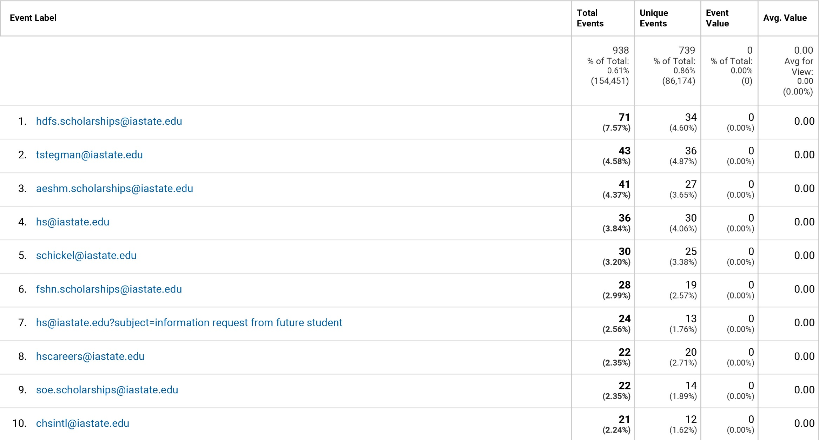
CHS Email Contacts

Slide 49
CHS Audience Browser Size
1920 x 1080 9.99%
1680 x 1050 7.67%
1600 x 900 13.89%
1440 x 900 9.35%
1366 x 728 17.12%
1280 x 1024 6.55%
1280 x 800 10.95%
1024 x 768 2.39%

